Slide 1

healthcare Analysis

Slide 2






Our team
Venkata Satyanarayana B
Scrum Master
Chaitanya Sri Ch
Mounika G
Sushmitha I
Ramya Sai P
Vyshnavi D
Data Engineer
Data Engineer
Data Engineer
Data Engineer
Data Engineer

Slide 3

Table of contents
Architecture Diagram
Data Description
Data Ingestion
Data Cleaning
Analysis & Queries
Visualization
Conclusion

Slide 4
Objective
The primary objective of this project is to design and implement a comprehensive healthcare data analysis system that integrates multiple data sources, including patient records, insurance details, prescriptions, and pharmacy inventories. The goal is to: Enable efficient ETL processes for large-scale healthcare datasets. Ensure data cleaning and standardization for accurate analysis. Perform advanced queries and analytics using PySpark, Hive, and Spark Streaming. Develop visualizations and dashboards (e.g., Power BI) to support decision-making for healthcare providers and insurers.

Slide 6
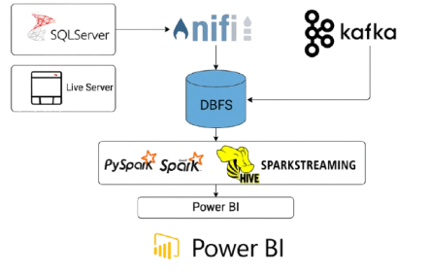

Slide 7

SOURCE
FILES

Slide 8
CSV files and Descriptions
Person: Stores personal details of individuals such as name, phone number, gender, and address reference.
Patient: Represents patients with unique SSN and date of birth, linked to address.
Address: Contains address details including street, city, state, and zip code for persons, pharmacies, and insurance companies.
Disease: Holds information about diseases including name and description.
Treatment: Links treatments to claims and diseases, representing medical procedures.
Claim: Represents insurance claims associated with treatments and linked to insurance plans.
Insurance Company: Stores details of insurance companies including name and address.
Insurance Plan: Represents insurance plans offered by companies, identified by UIN.
Pharmacy: Stores pharmacy details such as name, phone, and address.
Prescription: Links prescriptions to pharmacies and treatments.
Medicine: Contains details of medicines including product name, description, price, and manufacturer.
Contain: Junction table linking prescriptions to medicines with quantity information.
Keep: Tracks medicine stock in pharmacies with quantity details.

Slide 9
DATA INGESTION

Slide 10
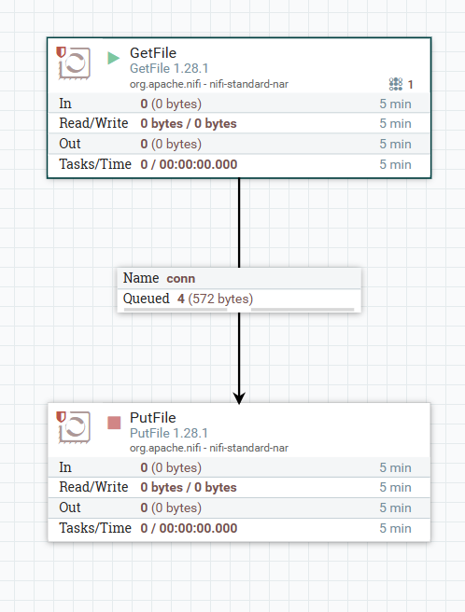
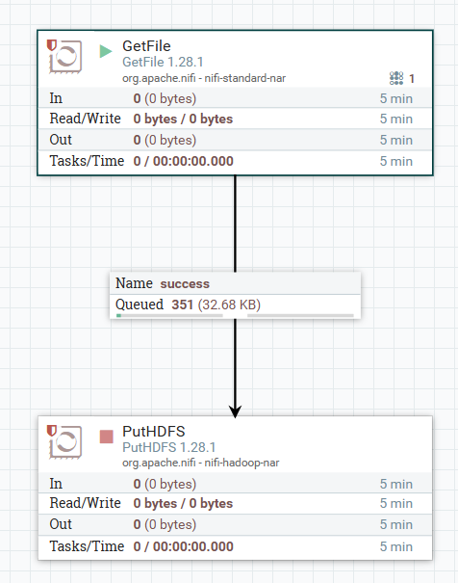
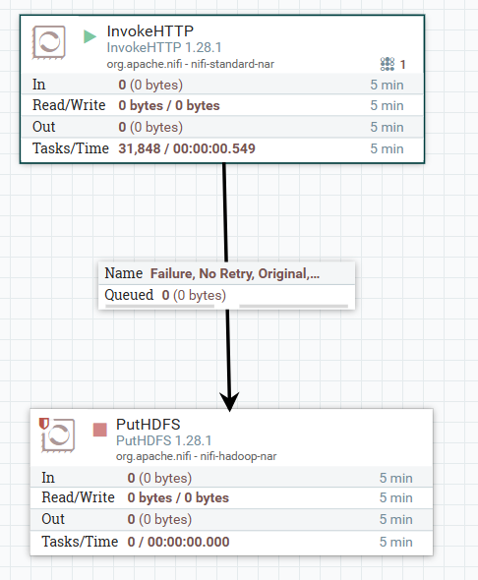
Batch ETL
Streaming ETL

Slide 11
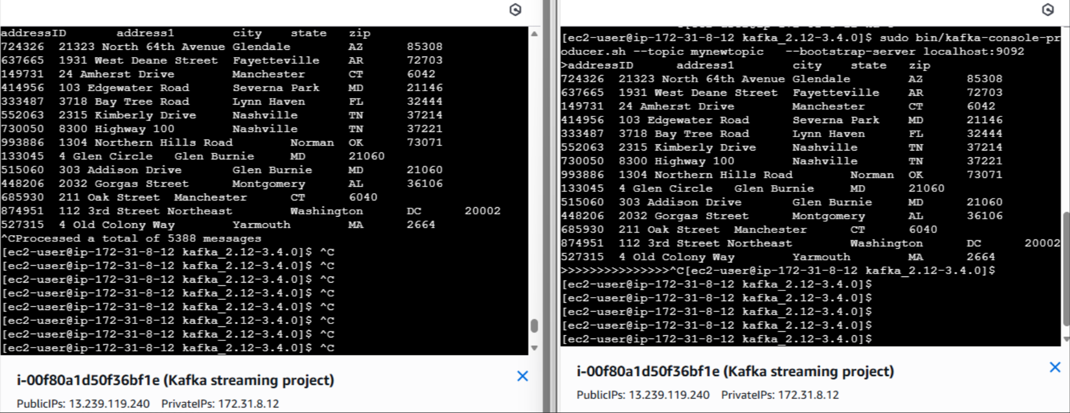
Kafka streaming ETL

Slide 12
Challenges
Data Complexity & Volume:
Handling diverse datasets such as patient details, insurance claims, prescriptions, and medicine inventories posed challenges in terms of integration and scalability.
Data Quality Issues:
Inconsistent formats, missing values, and duplicate records required extensive cleaning and validation to ensure reliability.

Slide 13
DATA CLEANING

Slide 14
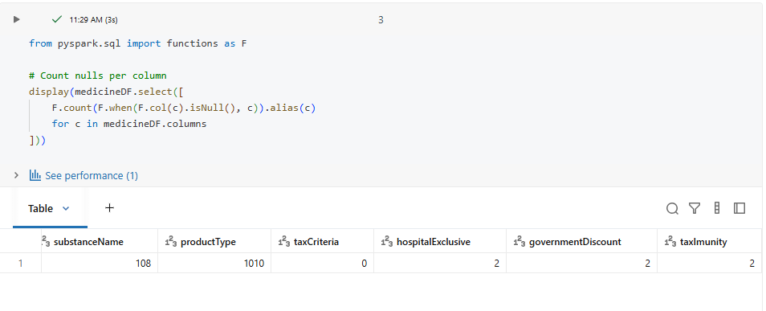
BEFORE DATA CLEANING

Slide 15
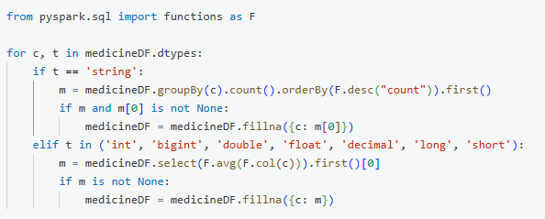
DATA CLEANING

Slide 16
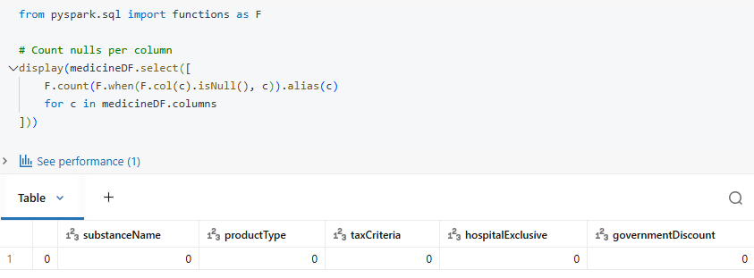
AFTER DATA CLEANING

Slide 17
Analysis & Queries

Slide 18
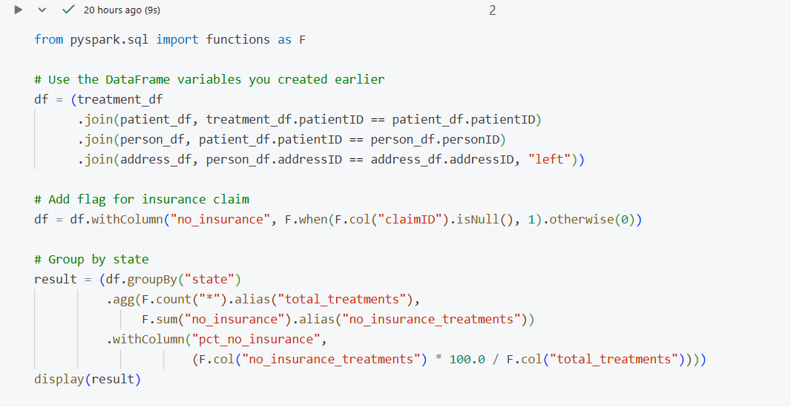
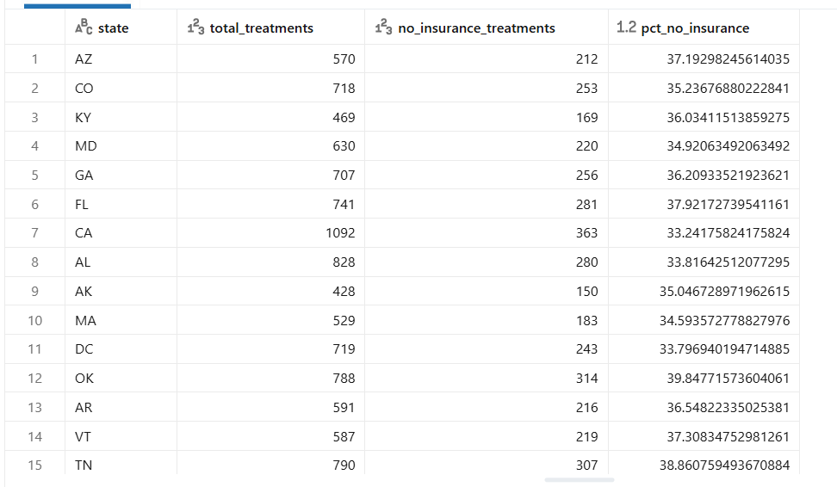
State wise No of Insurance Treatment Rate

Slide 19
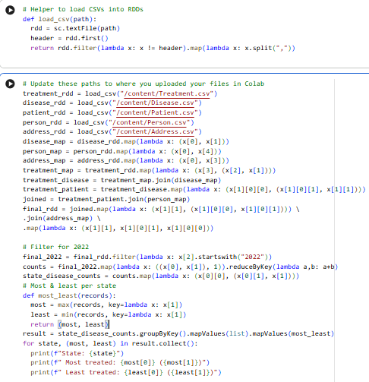
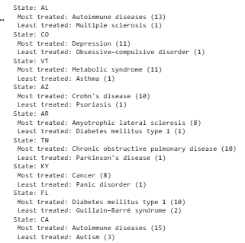
State-wise Analysis of Most and Least Treated Diseases in 2022

Slide 20
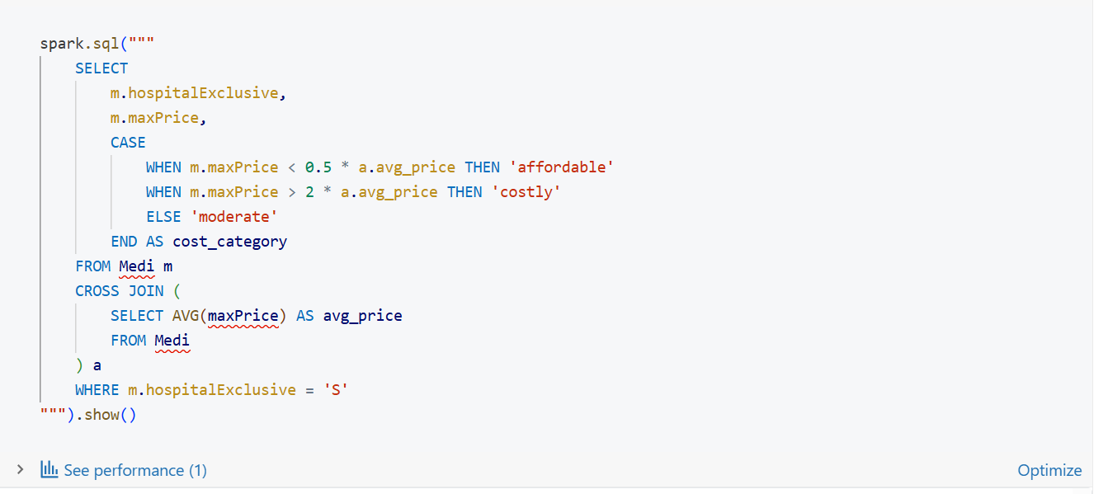
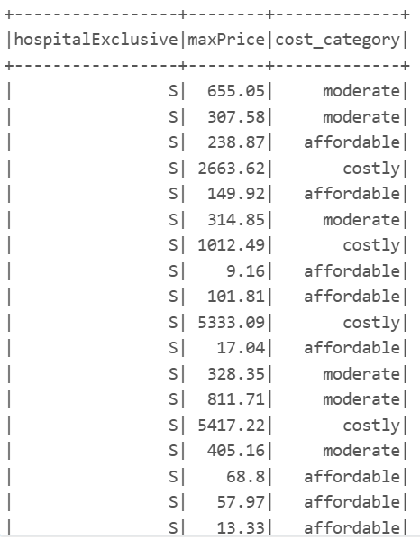
Filter Hospital-Exclusive Medicines by Cost

Slide 21
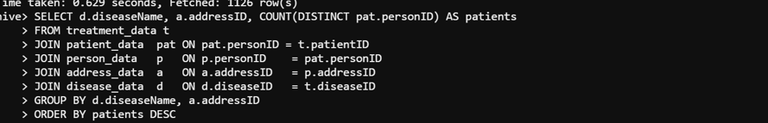
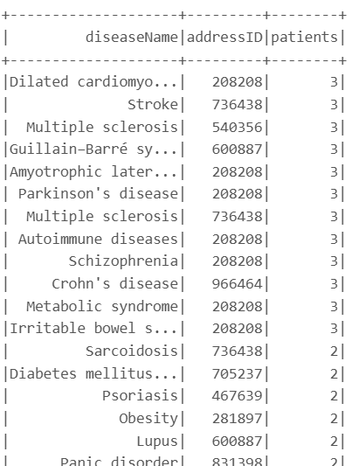
No of Households per disease

Slide 22
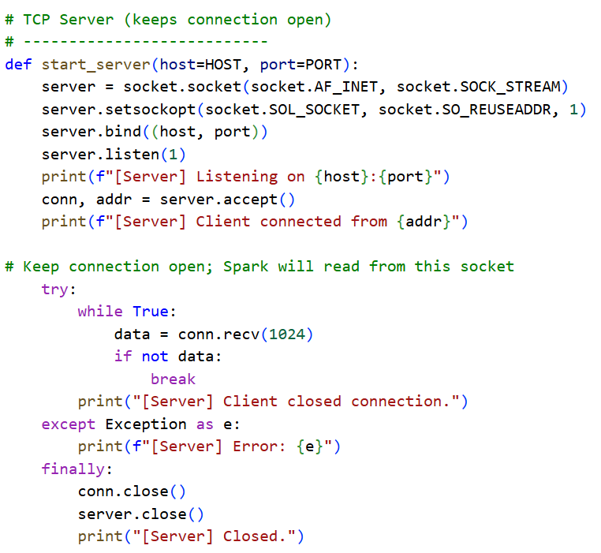
Spark Streaming

Slide 23
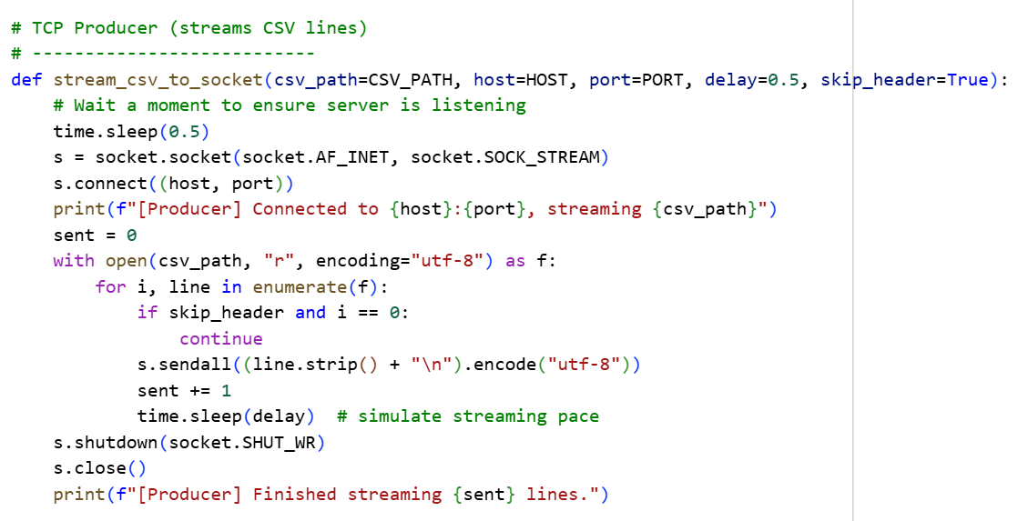

Slide 24
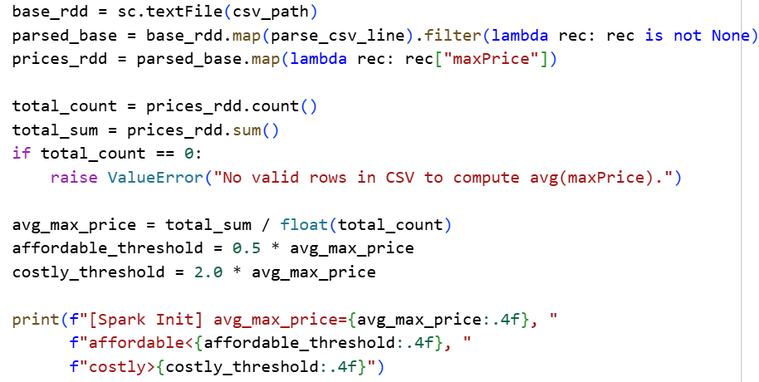
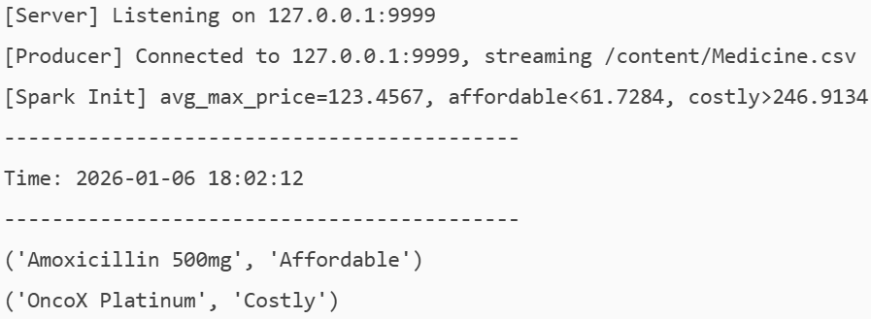

Slide 25
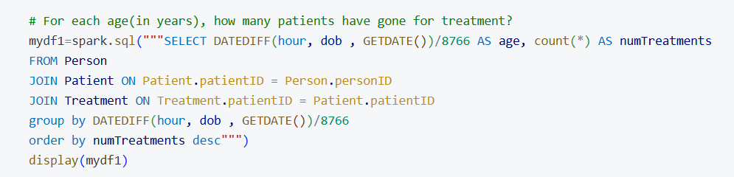
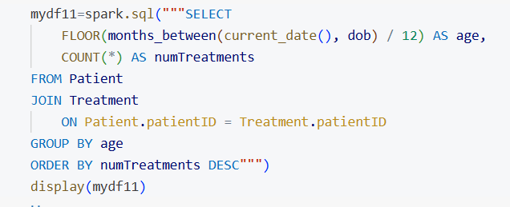
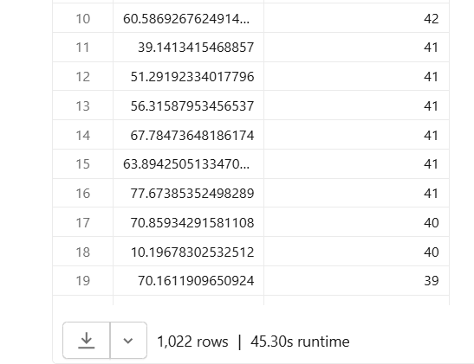
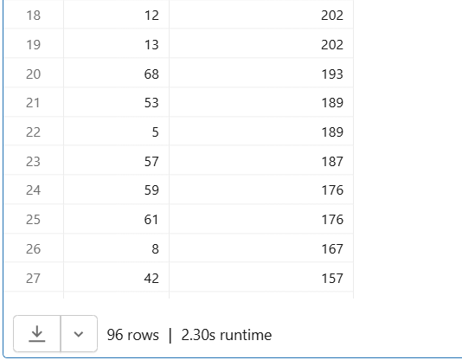
Query Optimization

Slide 26
Visualization

Slide 27
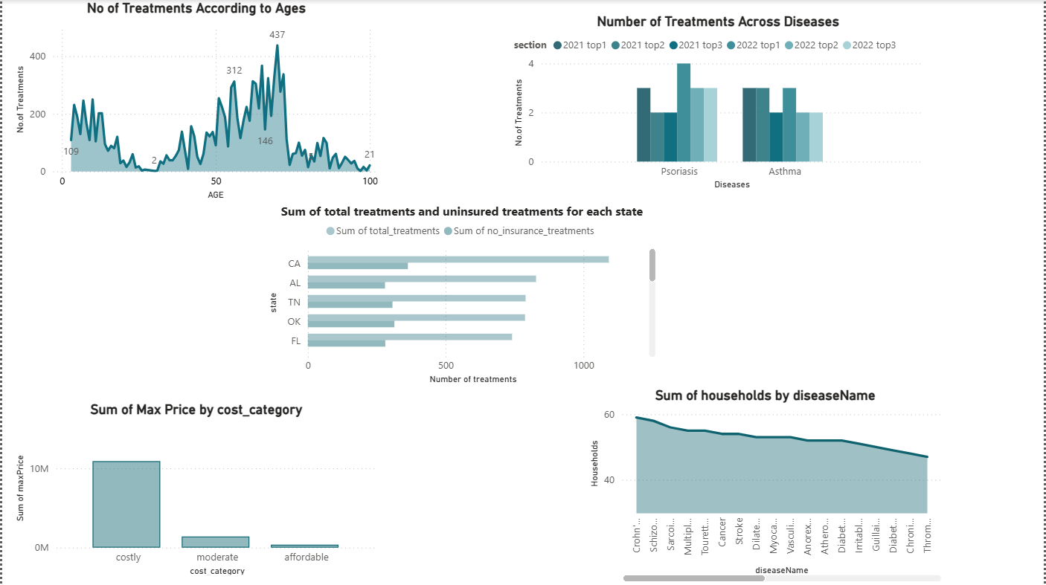

Slide 28
Conclusion
The project successfully established a scalable and efficient healthcare data analysis framework. By leveraging PySpark, Hive, and Power BI, the team achieved: Clean and integrated datasets ready for advanced analytics. Real-time data processing capabilities for dynamic healthcare environments. Actionable insights through interactive dashboards, aiding better decision-making for healthcare providers and insurers.

Slide 29

Thank you

Slide 30
Any questions?

